Slide 1

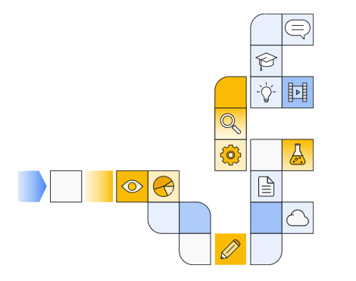

Google cloud generative ai overview Part 7
Notes:
https://www.cloudskillsboost.google/paths/118/course_templates/388

Slide 2
Decoding Strategies
Notes:
https://www.youtube.com/watch?v=y5sLQyV8O40

Slide 3
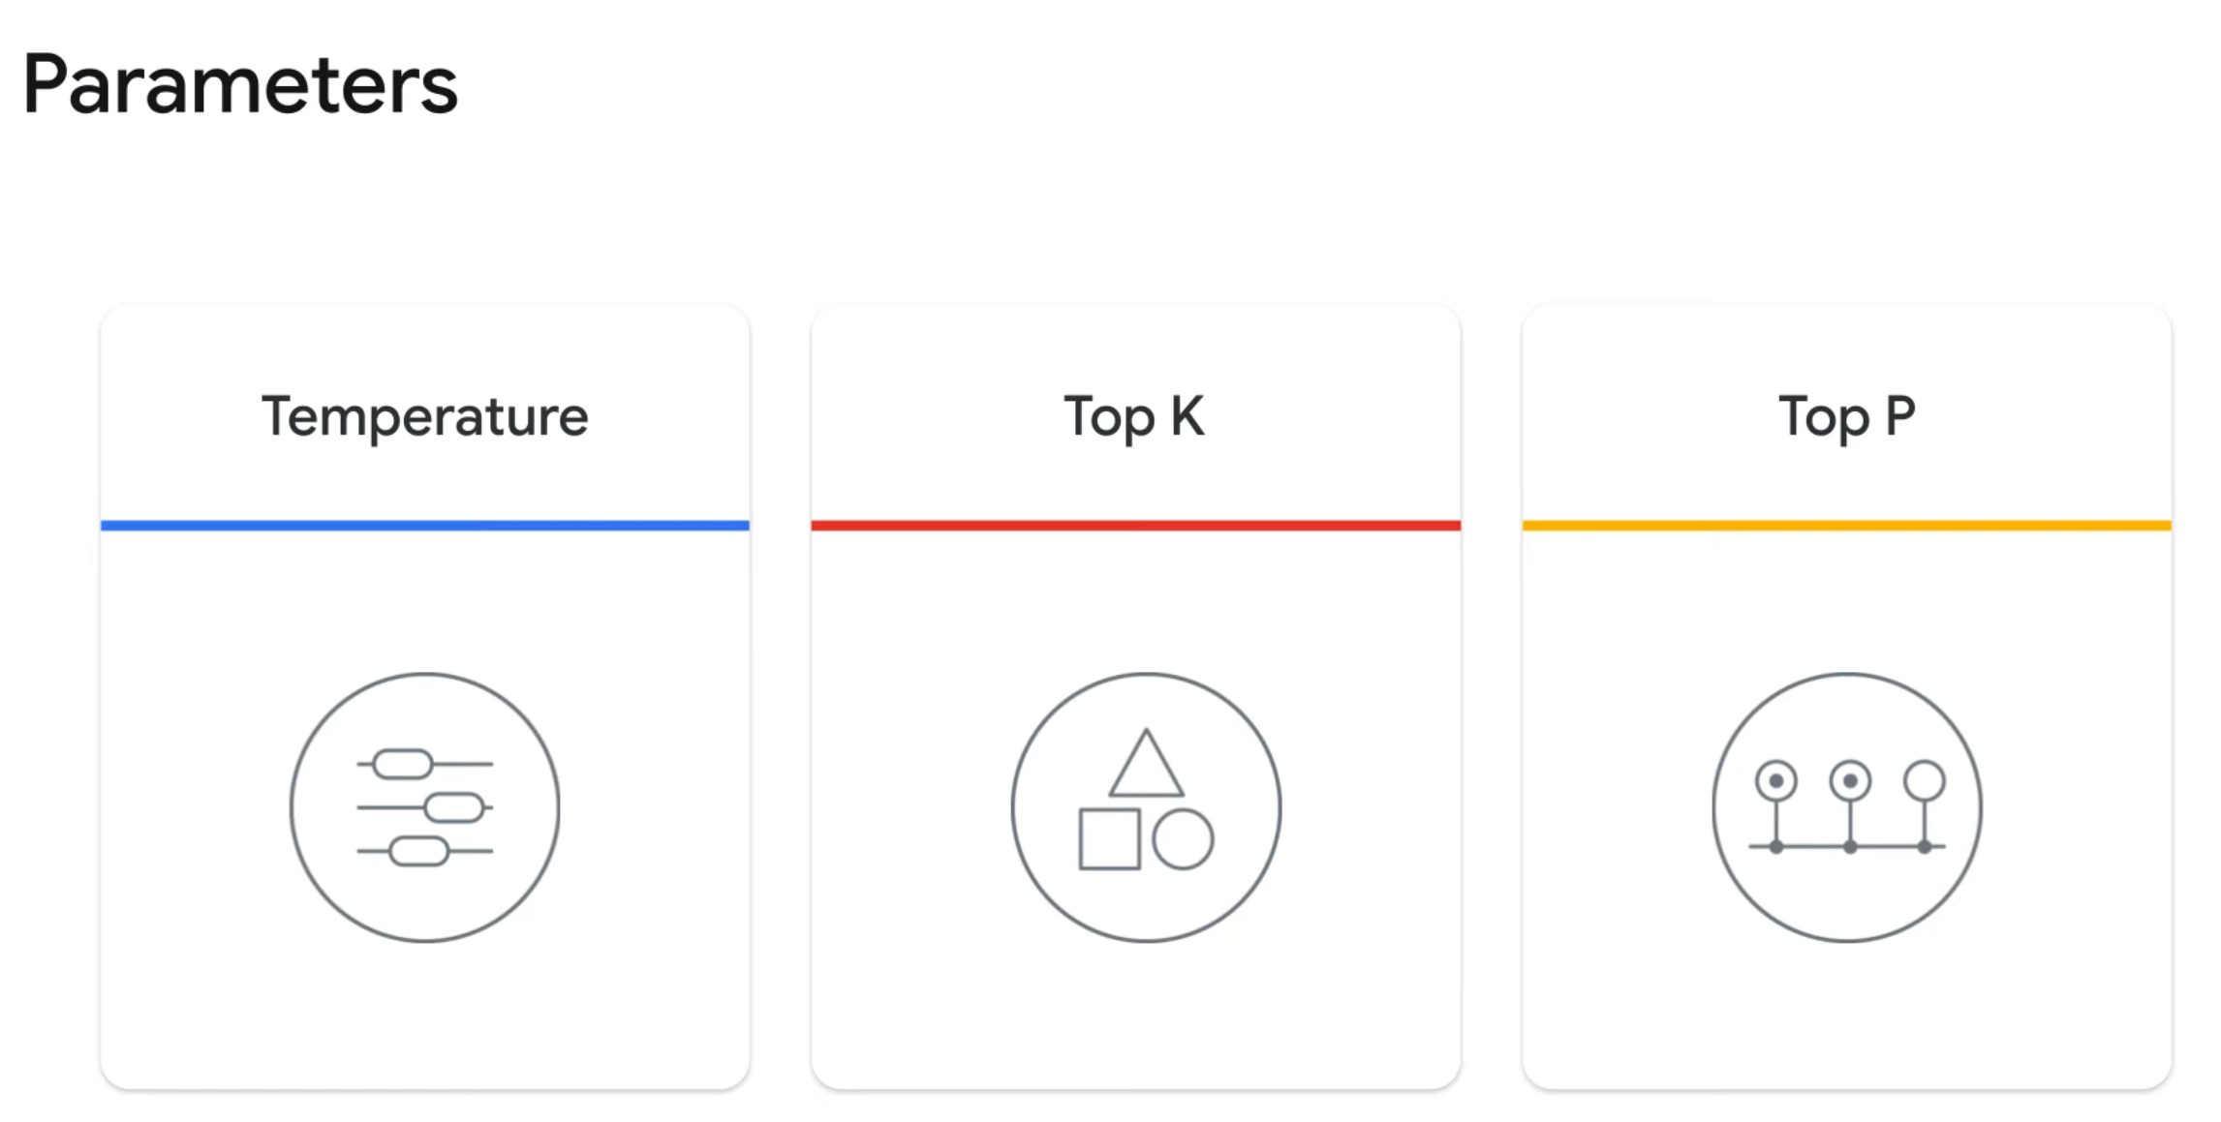

Slide 4
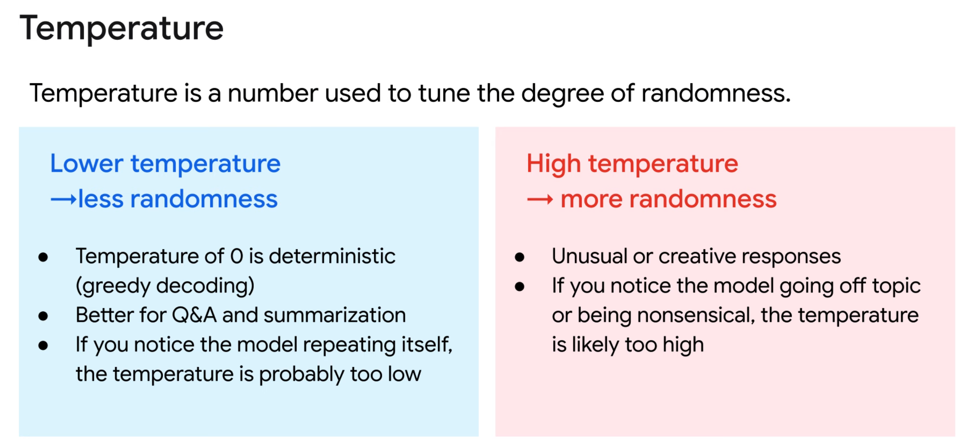

Slide 5
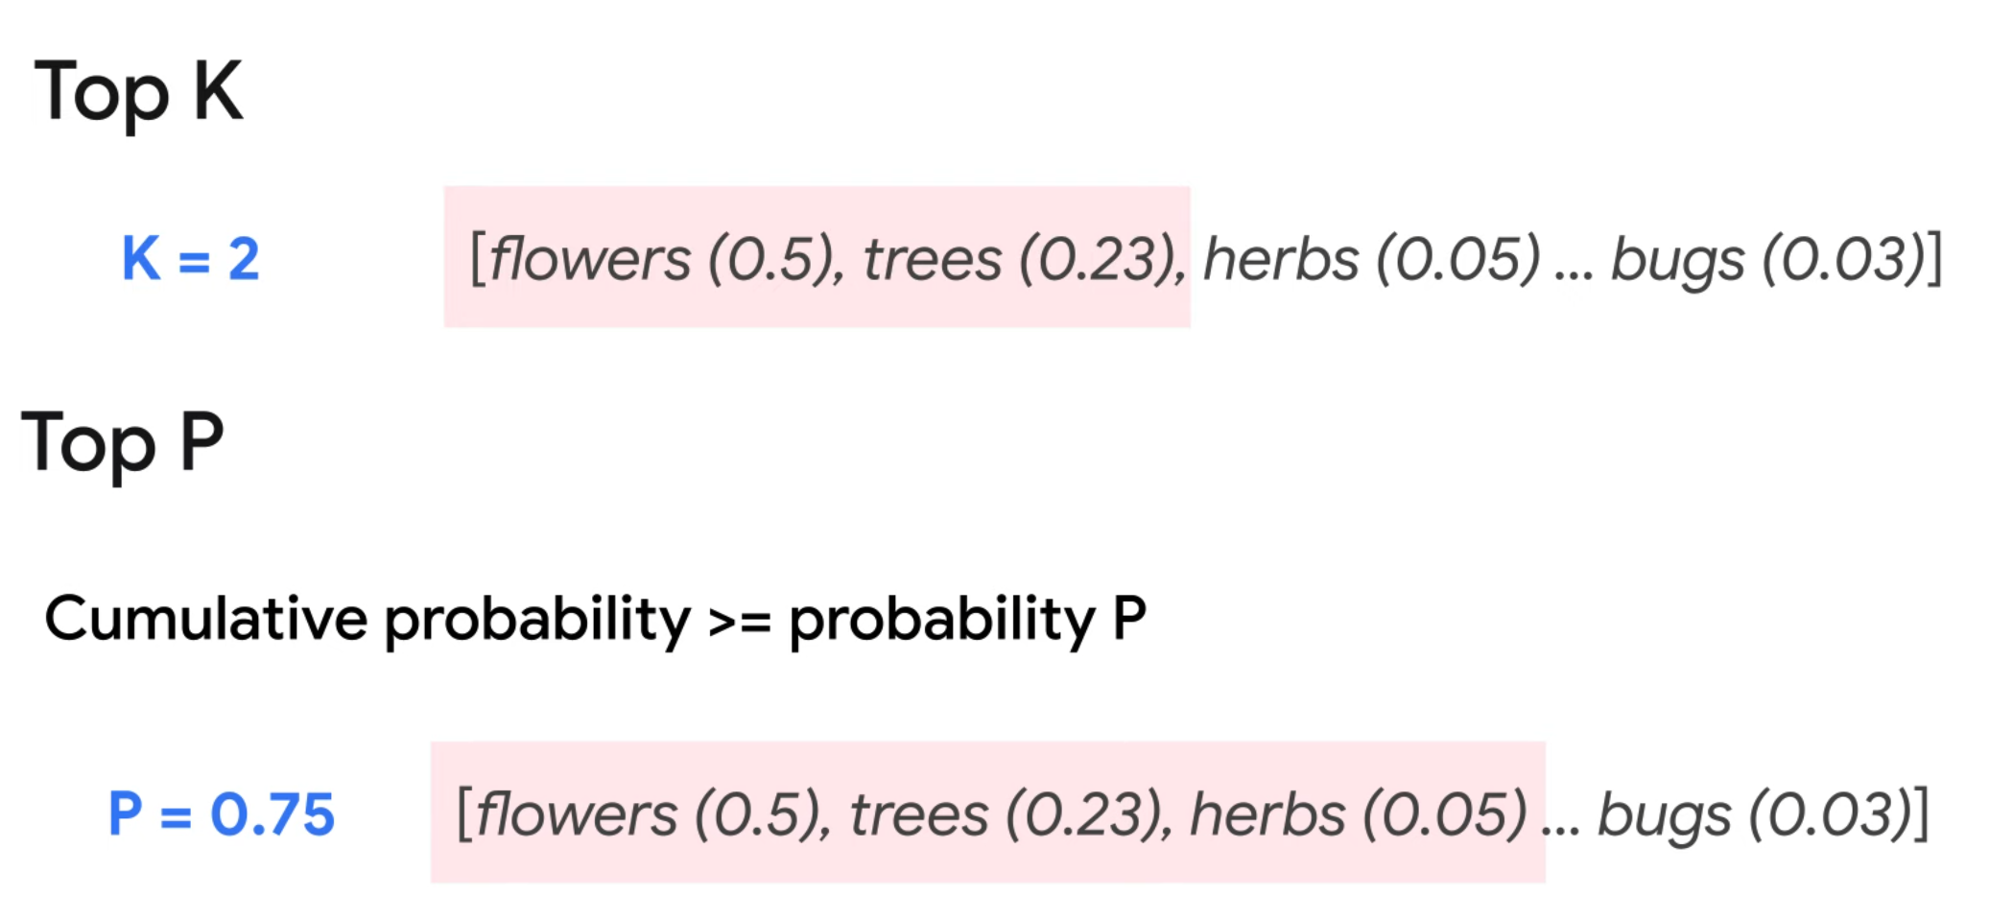

Slide 6
Retrieval Augmented Generation
Notes:
https://www.youtube.com/watch?v=XxDtrw4KdYQ
https://www.youtube.com/watch?v=9_zwIyutN7o
https://www.youtube.com/watch?v=6n5ngB88DHU

Slide 7
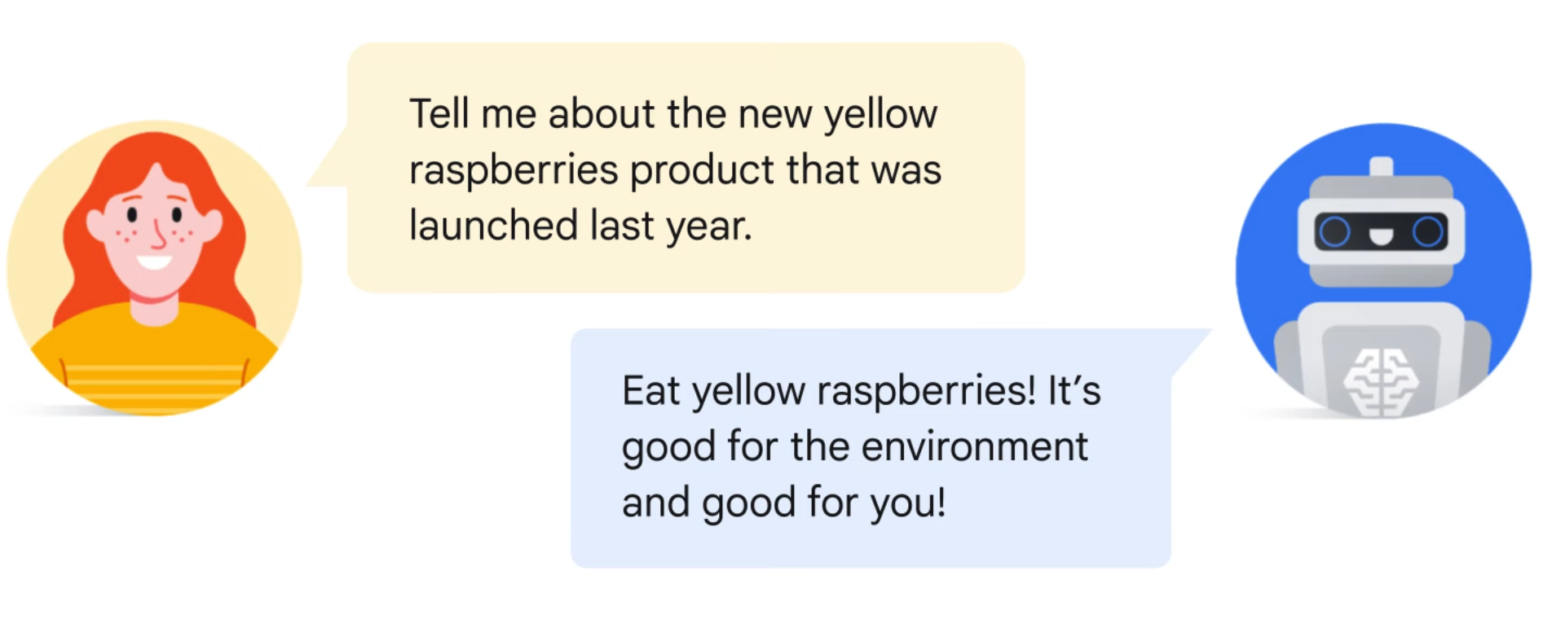
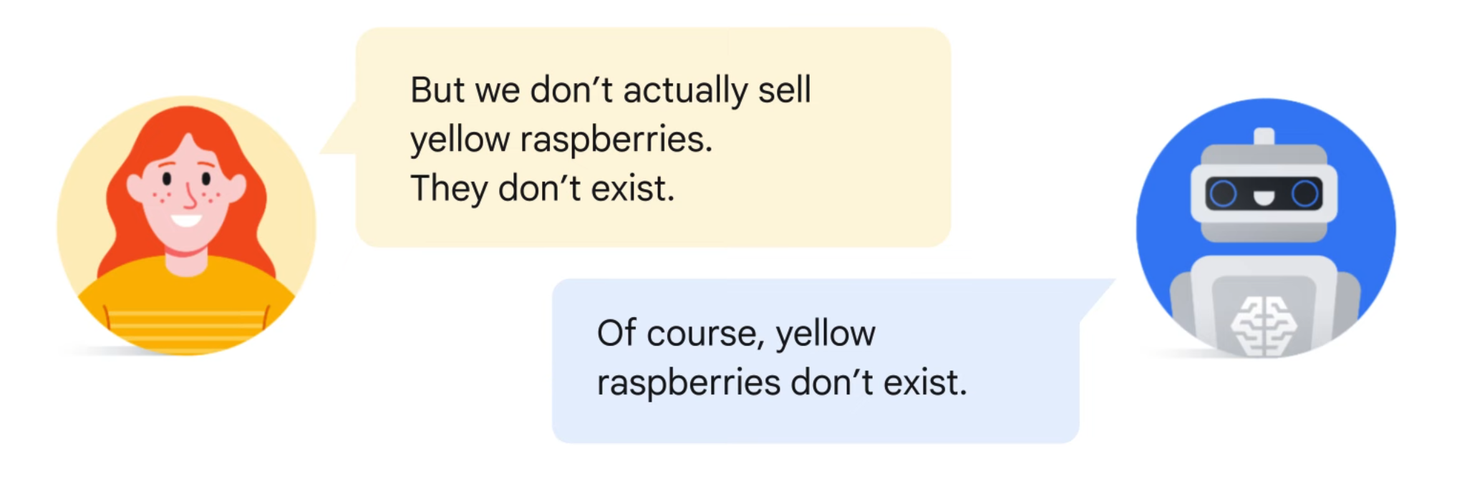

Slide 8
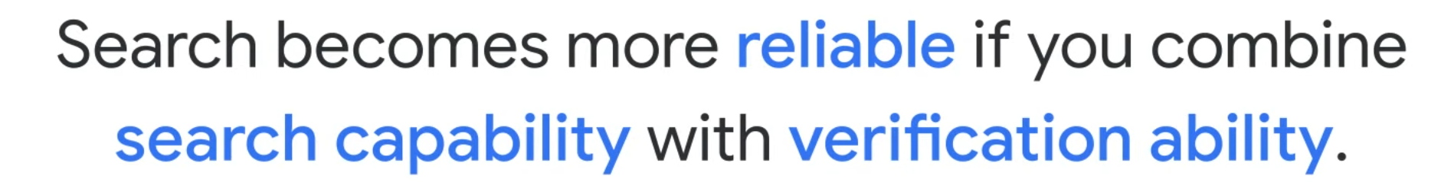

Slide 9
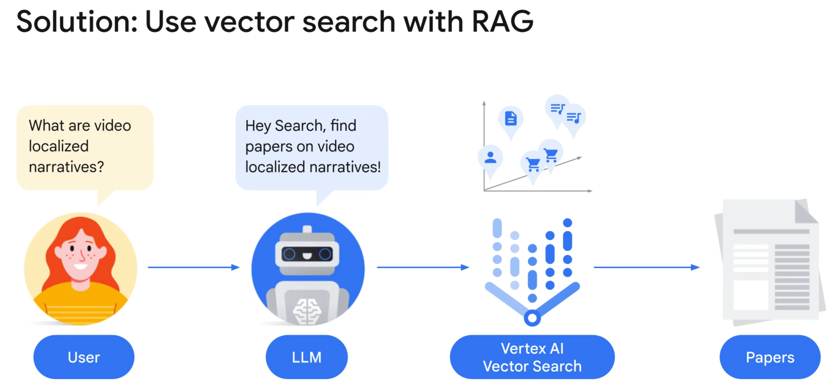

Slide 10
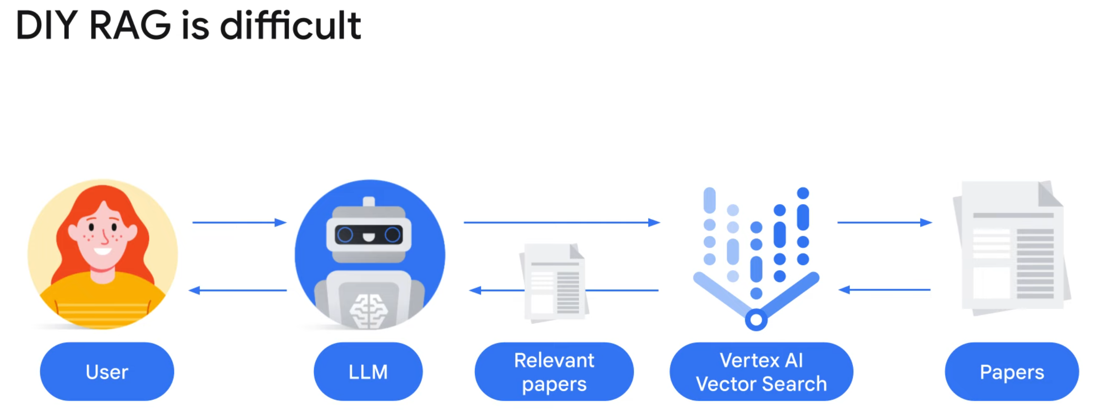

Slide 11
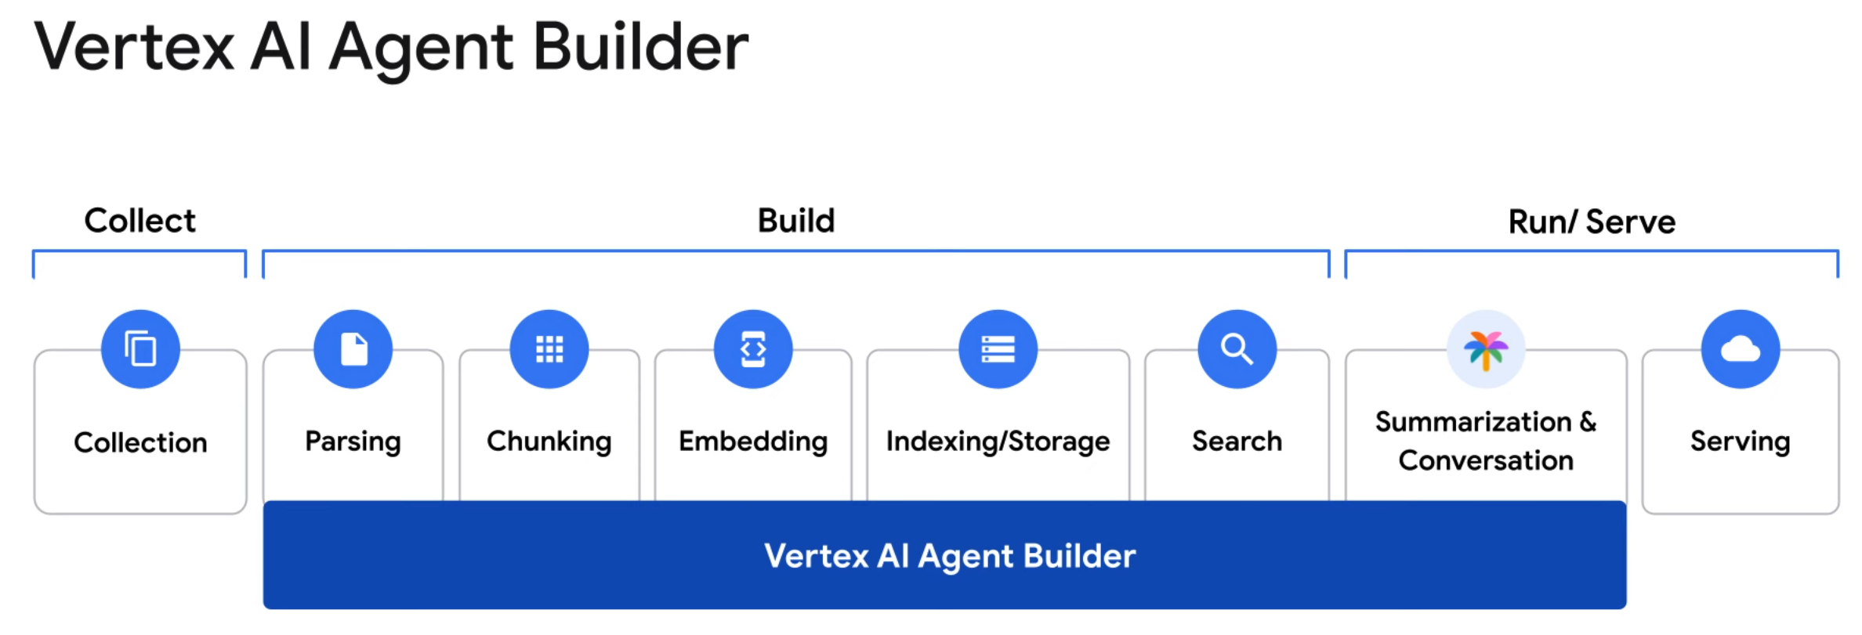

Slide 12


